Slide 1
MediAssist: Intelligent Medical Chatbot Using Large Language Models and NLP
DSA0307 – NATURAL LANGUAGE PROCESSING
Done by:
Viveka Sivanandham(192424128)
Rieona J (192424268)
T. Nikhitha (192424114)
Y Greeshma Reddy(192424146)
Guided by:
Dr. K. Anbazhagan
Professor

Slide 2


ABSTRACT
MediAssist is an intelligent medical chatbot developed using Large Language Models (LLMs) and Natural Language Processing (NLP).
The system allows users to register, manage patient profiles, and enter symptoms using natural language.
NLP techniques identify and understand relevant symptoms, while the LLM-based chatbot provides interactive medical assistance.
The system provides disease prediction, recommendations, medical report generation, and emergency assistance based on the user's health information.
MediAssist provides a user-friendly platform for preliminary healthcare support and does not replace professional medical diagnosis.

Slide 3
INTRODUCTION
MediAssist is an AI-powered medical chatbot designed to provide users with preliminary healthcare assistance.
It uses Natural Language Processing (NLP) to understand symptoms described in natural language.
Large Language Models (LLMs) are used to interact with users and provide understandable medical information.
The system analyzes symptoms and generates possible disease predictions and healthcare recommendations.
It maintains patient profiles and generates reports based on the interaction.
An Emergency Assistance feature helps identify potentially critical situations and guides users toward appropriate immediate care.
MediAssist is intended as a decision-support and informational system, not a replacement for professional medical diagnosis.

Slide 4
LITERATURE REVIEW
Title | Author | Year | Methodology | Inferences
The Diagnostic and Triage Accuracy of Digital and Online Symptom Checkers | Gilbert et al. | 2022 | Evaluates digital symptom checkers for diagnosis and triage using patient symptoms and health information. | Shows the potential of symptom checkers but highlights the need for improved diagnostic and triage accuracy. (Nature)
GatorTron: A Large Language Model for Clinical Natural Language Processing | X. Yang et al. | 2022 | Uses a large Transformer-based clinical language model for clinical concept extraction, relation extraction, and medical question answering. | Demonstrates that large clinical language models can improve NLP tasks involving unstructured medical information. (MedRxiv)
Towards Expert-Level Medical Question Answering with Large Language Models | K. Singhal et al. | 2023 | Develops and evaluates Med-PaLM/Med-PaLM 2 for medical question answering using large language models and medical fine-tuning. | Demonstrates strong performance in medical question answering and potential for AI-assisted healthcare. (arXiv)
A Vignette-Based Evaluation of ChatGPT's Ability to Provide Medical Advice | A. J. Nastasi et al. | 2023 | Evaluates ChatGPT's medical responses using clinical vignettes across different healthcare contexts. | Shows useful capabilities but emphasizes the importance of evaluating accuracy, appropriateness, and equity of AI-generated medical advice. (Nature)
A Survey on Medical Large Language Models: Technology, Application, Trustworthiness, and Future Directions | L. Liu et al. | 2024 | Reviews medical LLM technologies, healthcare applications, evaluation methods, and issues such as privacy, fairness, and reliability. | Identifies medical LLMs as promising tools while emphasizing safety, trustworthiness, privacy, and responsible deployment. (arXiv)

Slide 5
EXISTING SYSTEM
Users mainly depend on search engines and general health websites for symptom information.
Existing symptom checkers generally provide predefined questions and responses.
Many systems provide limited interaction and may not understand detailed natural-language descriptions.
Separate applications may be required for symptom checking, consultation, and report preparation.
Emergency situations may not always be clearly highlighted to the user.

Slide 6
PROBLEM IDENTIFICATION
LIMITED PERSONALIZATION-Patient information is not always considered during symptom analysis.
DIFFICULT SYMPTOM DESCRIPTION-Users may describe symptoms using different words and expressions.
LIMITED CONVERSATION-Traditional systems may provide only predefined responses.
LACK OF INTEGRATION-Authentication, symptom analysis, prediction and reporting may exist separately.
EMERGENCY IDENTIFICATION-Critical symptoms require immediate attention and clear guidance.

Slide 7
PROPOSED SYSTEM
Provides a single platform for patient profile management and medical assistance.
Collects symptoms using a simple conversational interface.
Uses NLP to understand symptoms expressed in natural language.
Uses an LLM to provide interactive responses and follow-up questions.
Predicts possible conditions and provides recommendations, reports, and emergency guidance.

Slide 8
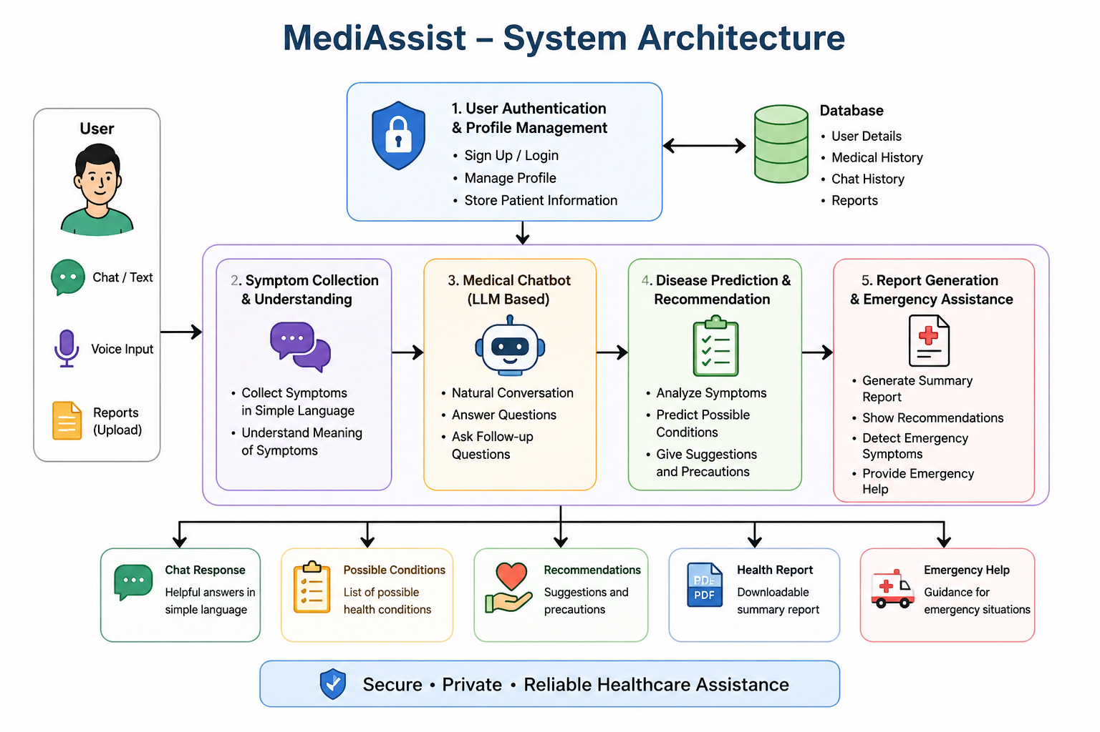
SYSTEM ARCHITECTURE

Slide 9
Module 1: User Authentication & Patient Profile Management
Purpose
To provide secure access and maintain relevant patient information.
Key Features
User registration and login
Secure authentication
Patient profile creation
Personal information management
Medical history storage
Previous symptom/interaction history
Profile update functionality
Role-based access if required
Input
Name
Age
Gender
Contact information
Medical history
Existing conditions
Allergies
Previous consultations
Output
Personalized patient profile that can be used by subsequent modules.

Slide 10
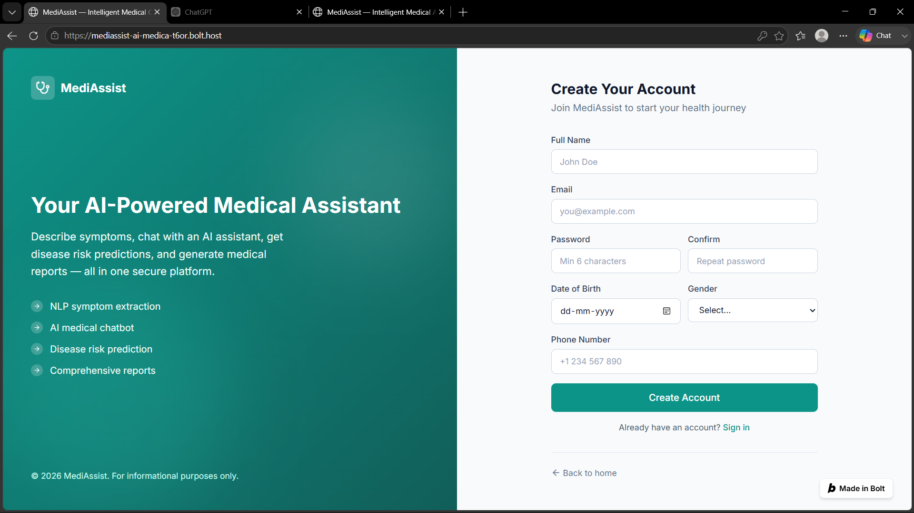
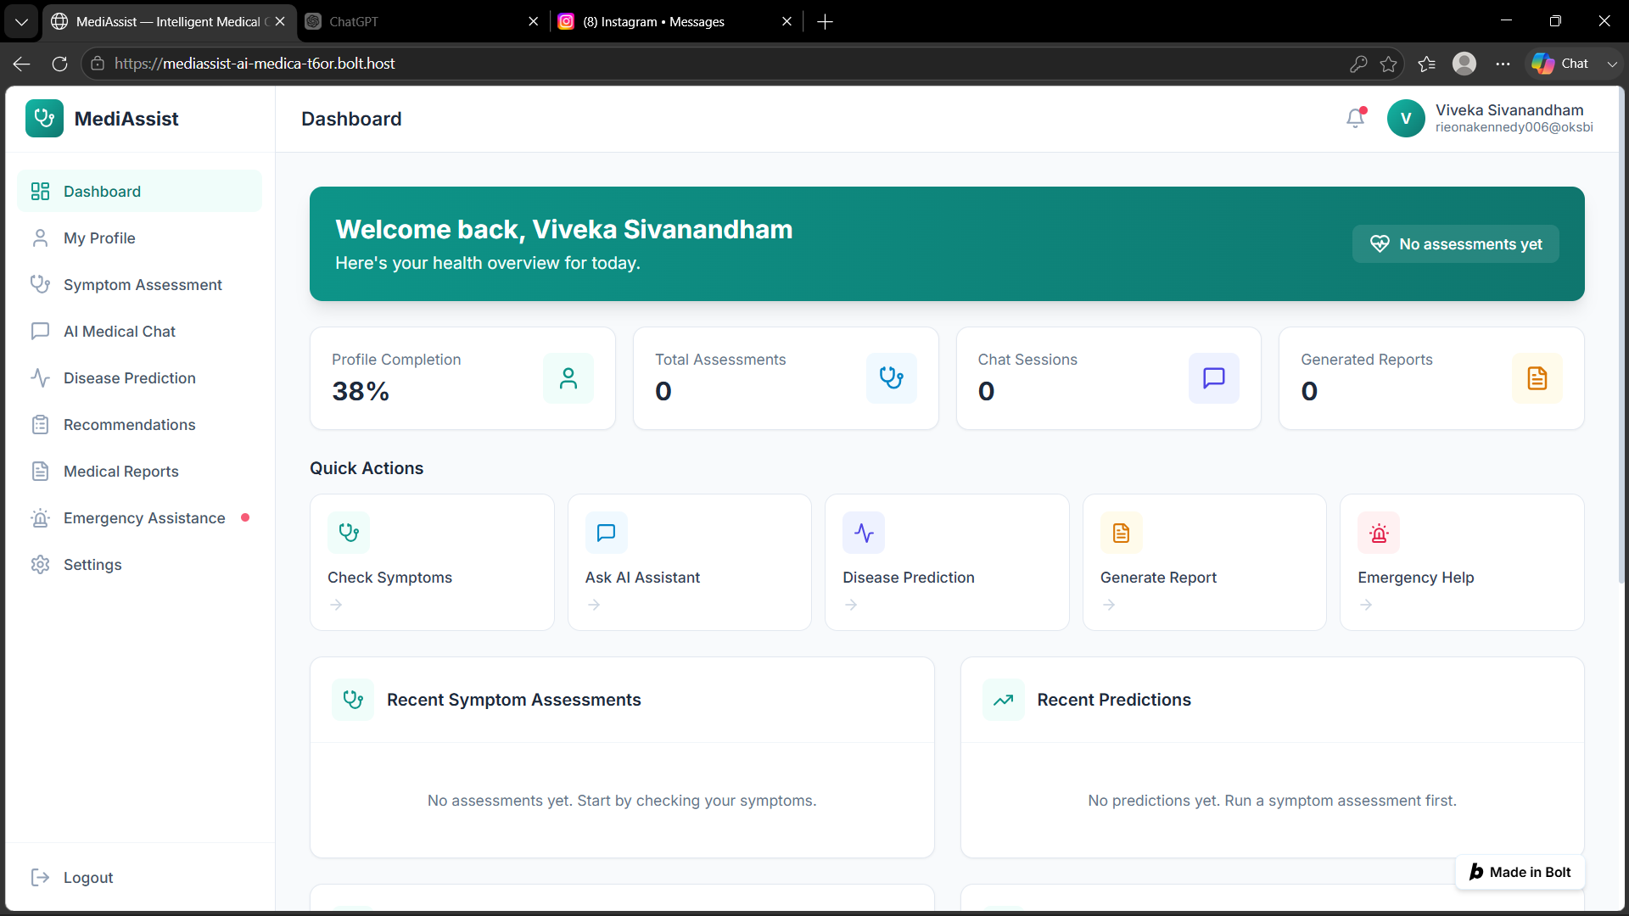
MODULE 1 OUTPUT

Slide 11
Module 2: Symptom Collection & NLP-Based Understanding
Key Features
Conversational symptom collection
Natural-language input
Text preprocessing
Tokenization
Named Entity Recognition
Symptom identification
Severity and duration extraction
Context understanding
Follow-up questions for missing information
Example
User:
"I have been having a severe headache and fever for two days."
NLP Output:
Symptom: Headache
Severity: Severe
Symptom: Fever
Duration: 2 days
This structured information is passed to the LLM and Disease Prediction Engine.
Flow
User Input → Text Processing → NLP → Symptom Extraction → Structured Symptoms

Slide 12
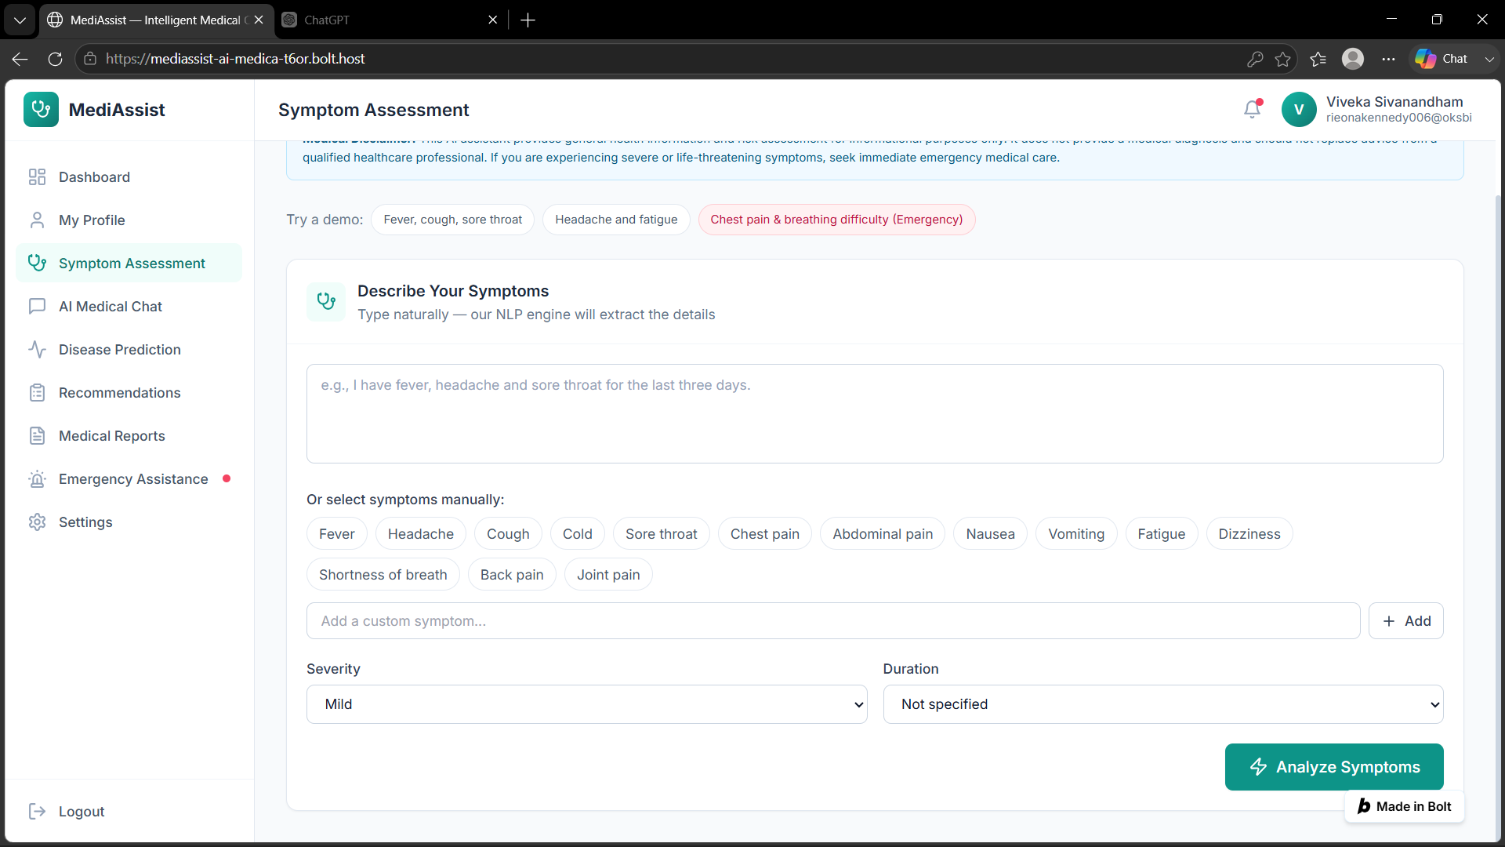
MODULE 2 OUTPUT

Slide 13
Module 3 – LLM-Based Medical Chatbot
Technologies Used
LLM: GPT / Llama / other suitable LLM
Framework: LangChain
Backend: Python
API: REST API
Prompt Engineering: Structured medical prompts
Knowledge Retrieval: RAG (Retrieval-Augmented Generation)
Vector Database: FAISS / ChromaDB
Functionality
Natural-language conversation
Context-aware responses
Follow-up questions
Medical information explanation
Personalized chatbot interaction
Flow
User Query → NLP → RAG/Medical Knowledge → LLM → Response

Slide 14
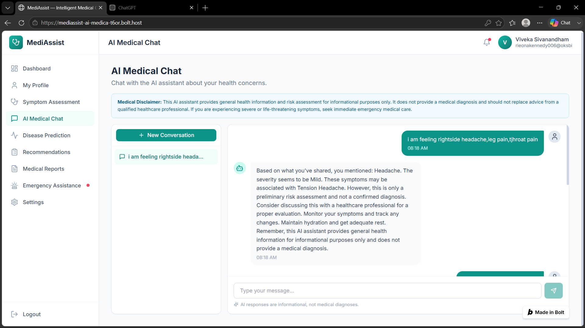
MODULE 3 OUTPUT

Slide 15
Module 4 – Disease Prediction & Recommendation Engine
Functionality
Analyze extracted symptoms
Predict possible diseases/conditions
Calculate risk/confidence
Generate personalized recommendations
Suggest appropriate next steps
Technologies Used
Machine Learning: Scikit-learn
Models: Random Forest / Decision Tree / XGBoost
Deep Learning: PyTorch
Data Processing: Pandas, NumPy
Feature Engineering: Python
Recommendation Engine: Rule-based + ML approach
Medical Dataset: Structured symptom-disease dataset
Flow
Symptoms → Feature Extraction → ML Model → Possible Conditions → Recommendation

Slide 16
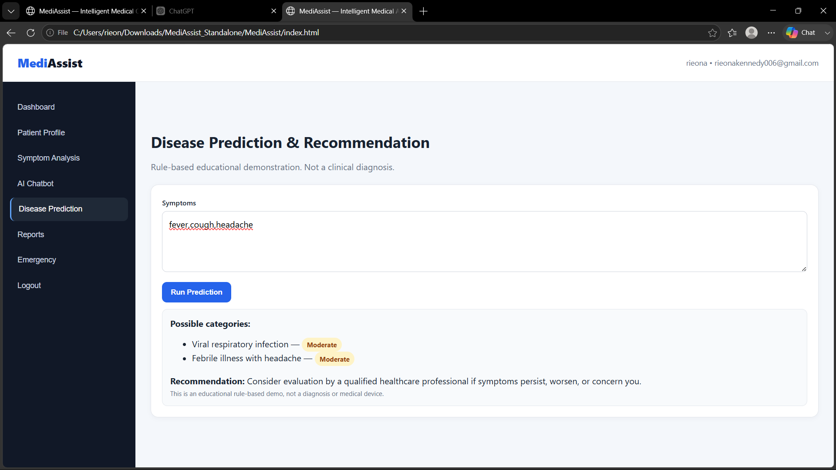
MODULE 4 OUTPUT

Slide 17
Module 5 – Report Generation & Emergency Assistance
Functionality
Generate patient interaction reports
Summarize symptoms and chatbot conversation
Store consultation history
Identify potentially critical symptoms
Provide emergency-oriented guidance
Technologies Used
Report Generation: Python / ReportLab
Backend: FastAPI / Flask
Database: MySQL / MongoDB
Emergency Detection: Rule-based system + ML
Notifications: Email/SMS API, if implemented
Frontend: React.js
Flow
Patient Data + Symptoms + Prediction → Report Generator → PDF Report
Critical Symptoms → Emergency Detection → Alert / Urgent Guidance

Slide 18
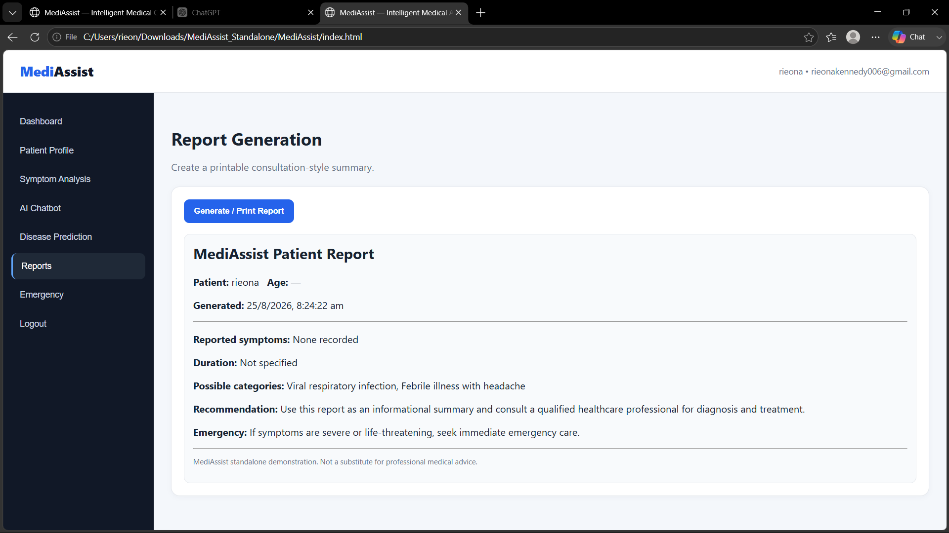
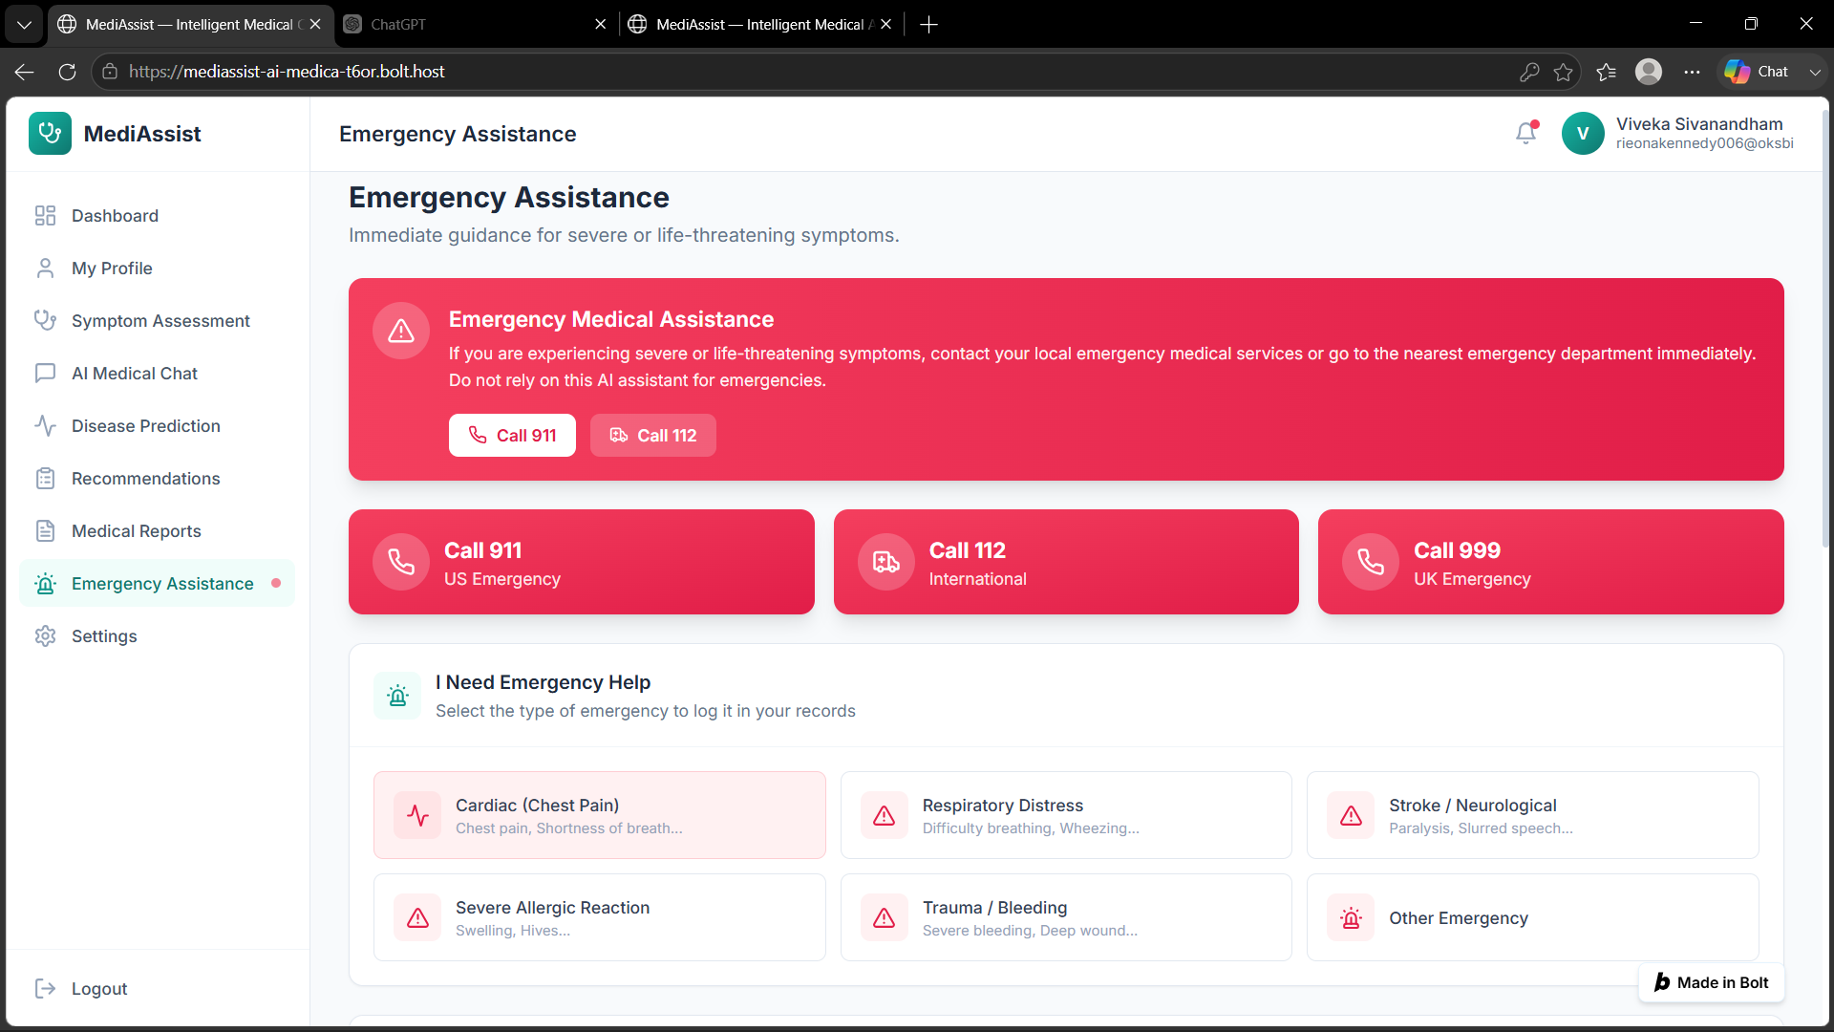
MODULE 5 OUTPUT

Slide 19
RESULTS & CONCLUSION
Successfully implemented secure user authentication and patient profile management for storing essential user information.
NLP-based symptom analysis identifies important symptoms from natural-language descriptions provided by the user.
The LLM-based chatbot provides interactive and understandable medical information based on user queries.
Disease prediction, recommendations, report generation, and emergency symptom detection are integrated into the system.
MediAssist provides a user-friendly healthcare support platform for preliminary assessment and assistance, while professional medical consultation remains essential.

Slide 20
FUTURE ENHANCEMENTS
Integration with wearable devices to collect real-time health parameters.
Support for multiple regional languages for better accessibility.
Integration with hospital/clinic systems for doctor consultation and appointment booking.
Improved disease prediction using larger and more diverse medical datasets.
Voice-based interaction and advanced emergency detection for faster assistance.

Slide 21
REFERENCES
Wallace, W., Chan, C., Chidambaram, S., et al. (2022). The diagnostic and triage accuracy of digital and online symptom checker tools: A systematic review. npj Digital Medicine, 5, 118. DOI: 10.1038/s41746-022-00667-w.
Yang, X., PourNejatian, N., Shin, H. C., et al. (2022). GatorTron: A Large Language Model for Clinical Natural Language Processing. medRxiv. DOI: 10.1101/2022.02.27.22271257.
Singhal, K., Tu, T., Gottweis, J., et al. (2023). Towards Expert-Level Medical Question Answering with Large Language Models. arXiv preprint arXiv:2305.09617.
Nastasi, A. J., Courtright, K. R., Halpern, S. D., & Weissman, G. E. (2023). A vignette-based evaluation of ChatGPT’s ability to provide appropriate and equitable medical advice across care contexts. Scientific Reports, 13, 17885. DOI: 10.1038/s41598-023-45223-y.
Liu, L., Yang, X., Lei, J., et al. (2024). A Survey on Medical Large Language Models: Technology, Application, Trustworthiness, and Future Directions. arXiv preprint arXiv:2406.03712.

Slide 22
THANKYOU

